Slide 1

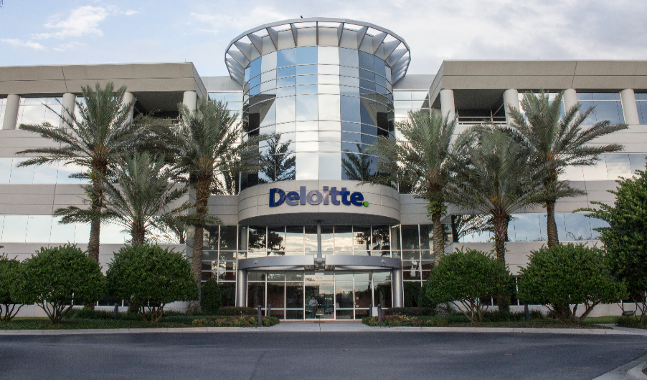
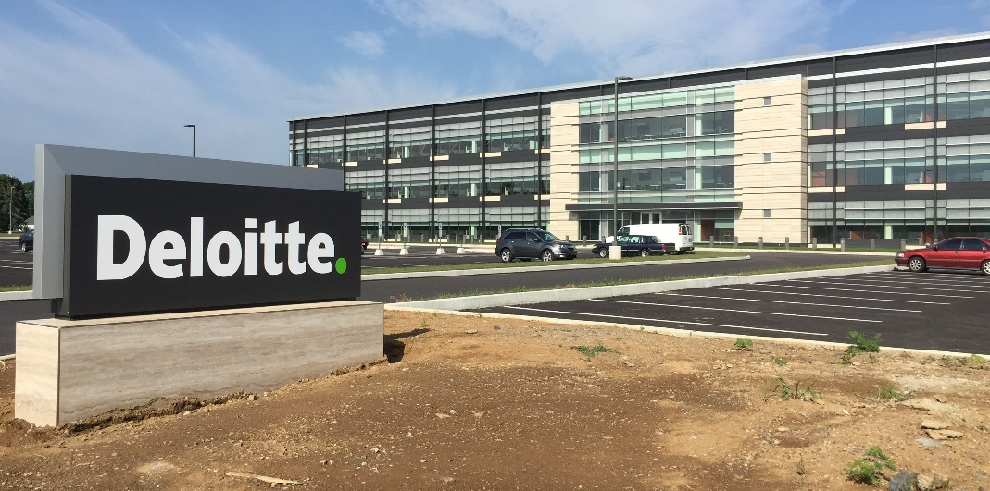

USDC Information Technology Center of Excellence (IT-CoE)
Topic: CompTIA Security+ Testing Review
Orlando, FL
Mechanicsburg, PA
Gilbert, AZ

Slide 2
Wireless and Mobile Security
Security+
Session 10
CompTIA Security+
Test: SYO-601
EXAM OBJECTIVES (DOMAINS)
The table below lists the domains measured by this examination and the extent to which they are represented:
Domain | Weight
1.0 Threats, Attacks and Vulnerabilities | 24%
2.0 Architecture and Design | 21%
3.0 Implementation | 25%
4.0 Operations and Incident Response | 16%
5.0 Governance, Risk, and Compliance | 14%
Total | 100%
Session 10
Includes Objectives from Domain 2, and 4
Objective 2.5 – Given a scenario, deploy mobile devices securely
Objective 4.4 – Given a scenario, differentiate common account management practices.

Slide 3
Wireless and Mobile Security
Security+
Session 10
Terminology
BYOD – Bring Your Own Device, adding a personal devices to the network requires security adherence to network security policies.
COPE – Company Owned and Provided Equipment, requires these devices comply with company security policies, and not be used in personal ways that conflict with the corporate User Acceptance Policy.
GSM – Global System for Mobile communication. Commonly known as 2G.
LTE – Long-Term Evolution is the standard for wireless communication of high-speed data for mobile devices. Commonly known as 4G.
UMTS – Universal Mobile Telecommunications System, This is the 3G standard based on GSM, an improvement over GSM.

Slide 4
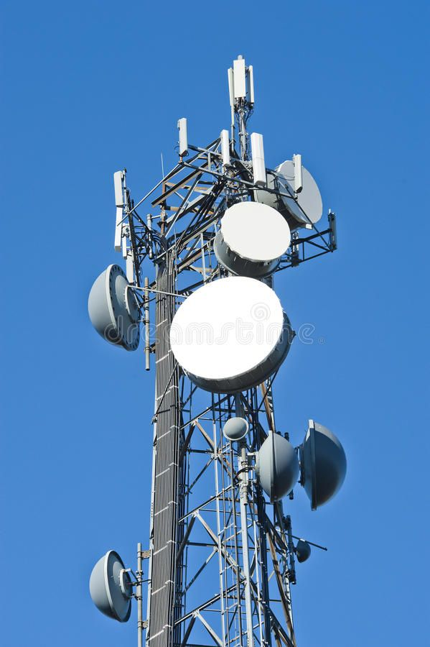
Wireless and Mobile Security
Security+
Session 10
Connection Types
Cellular Standards
GSM: Global System for Mobile Communication (2G)
EDGE: Enhanced Data Rates for GSM Evolution (2G/3G)
UMTS: Universal Mobile Telecommunications System (3G)
LTE: Long-Term Evolution (4G)
OFDM: Orthogonal Frequency-division Multiplexing (5G)

Slide 5
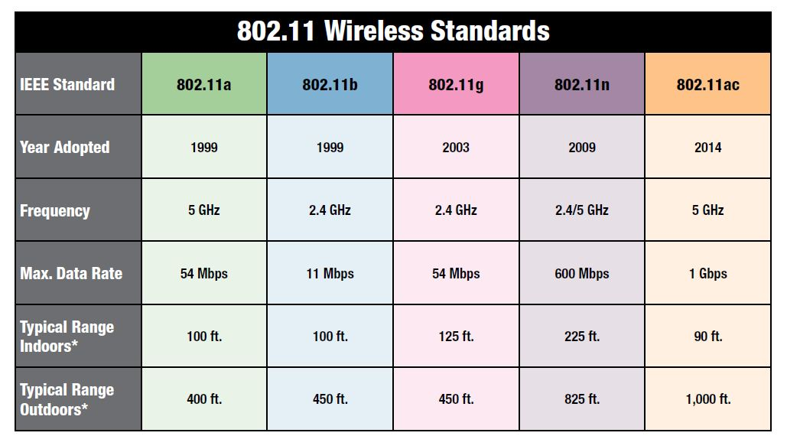
Wireless and Mobile Security
Security+
Session 10
Connection Types
Wi-Fi Standards
WiFi standards have evolved over the years and now the 802.11ax standard operates in both 5 GHz and 2.4 GHz and is backward compatible with previous versions creating more available channels and able to accommodate larger number of users.

Slide 6
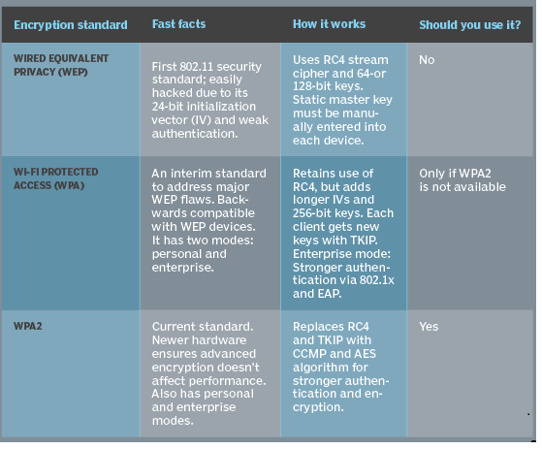
Wireless and Mobile Security
Security+
Session 10
Connection Types
Wireless Security
Three types: WEP, WPA, WPA2
Just remember: Don’t use WEP
Use WPA2

Slide 7
Wireless and Mobile Security
Security+
Session 10
Connection Types
WiFi Attacks
Disassociation – An attack in which the intruder sends a frame to the AP with a spoofed address to make it look like it came from the victim and disconnects them from the network.
Rogue Access Point – Is a Wireless Access Point that is connected to the network but is not an approved access point. This can lead to the Evil Twin attack where a Rogue Access Point is configured like a valid SSID.
Near Field Communication (NFC) – A radio wave transmission that automatically connects when it is within range. ApplePay with a cell phone is an example. This makes it susceptible to sniffing, and attacks.
Bluejacking – The sending of unsolicited messages over a Bluetooth connection.
Bluesnarfing – The gaining of unauthorized access through a Bluetooth connection.

Slide 8
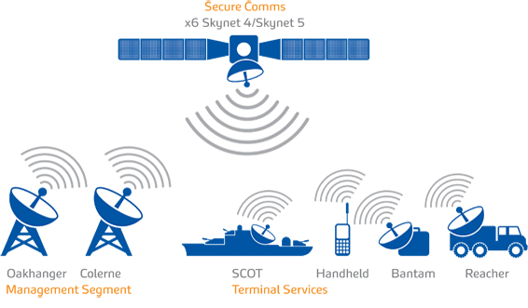
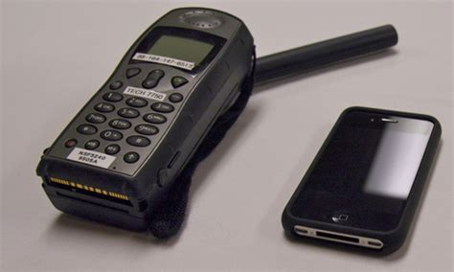
Wireless and Mobile Security
Security+
Session 10
Connection Types
SATCOM Communications
Handheld Satellite Communications phones available from companies like: Iridium, Inmarsat, Globalstar
Only works outdoors with direct line of sight to the satellite network. Does not work indoors.
Typically used by military and first responders, but available to general public.
Good communications backup for cellular service outages.

Slide 9

Wireless and Mobile Security
Security+
Session 10
Mobile Devices
BYOD – Bring Your Own Device
Connect to Guest Network to protect against viruses
Use of mobile devices on company property
Data ownership on personal devices
Adherence to corporate policies
Legal concerns with personal device doing corporate activities
Technical concerns / technical support
Maintaining current patches
Personal device having corporate proprietary information
Acceptable Use policy
Exfiltration of data

Slide 10
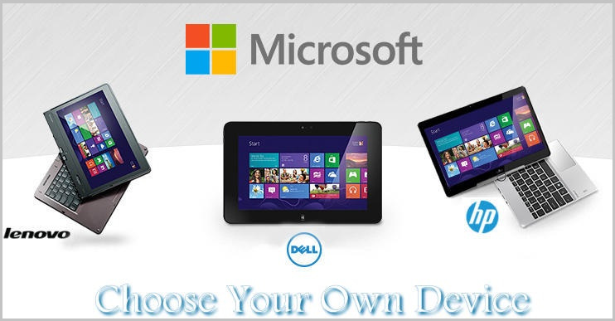
Wireless and Mobile Security
Security+
Session 10
Mobile Devices
CYOD – Choose Your Own Device
List of approved devices that meet company standards.
Select from this list to use for company business.
This is your personal device but approved for company business.
COPE – Company Owned and Provided Equipment
Company owns the mobile device and controls all aspects to provide the highest level of security.

Slide 11
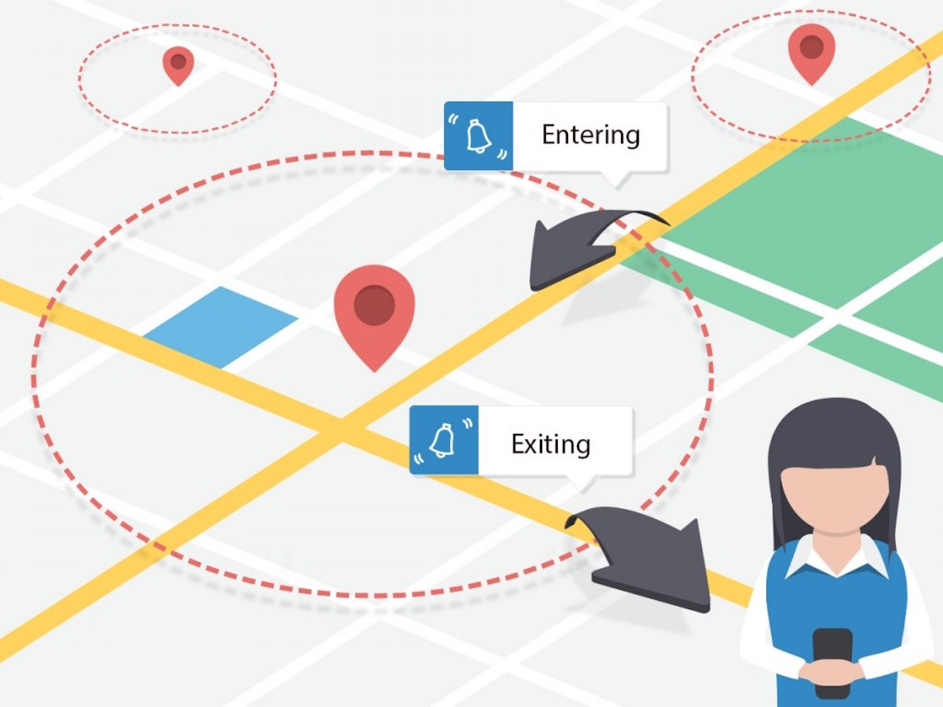
Wireless and Mobile Security
Security+
Session 10
Mobile Devices
Geofencing
Identifies mobile users within a geofence and can trigger pre-programmed actions when users enter the geofence or leave the geofence area.
This could include notices sent, access allowed or denied, etc.

Slide 12
Wireless and Mobile Security
Security+
Session 10
Mobile Devices
Knowledge Check 1
A company is using a mobile device deployment model in which employees use their personal devices for work at their own discretion. Some of the problems the company is encountering include the following:
There is no standardization.
Employees ask for reimbursement for their devices.
Employees do not replace their devices often enough to keep them running efficiently.
The company does not have enough control over the devices.
Which of the following is a deployment model that would help the company overcome these problems?
A. BYOD
B. VDI
C. COPE
D. CYOD

Slide 13
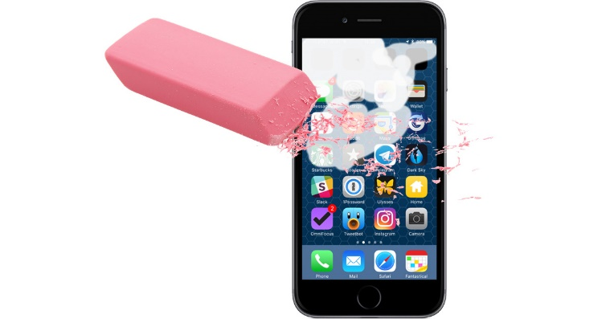
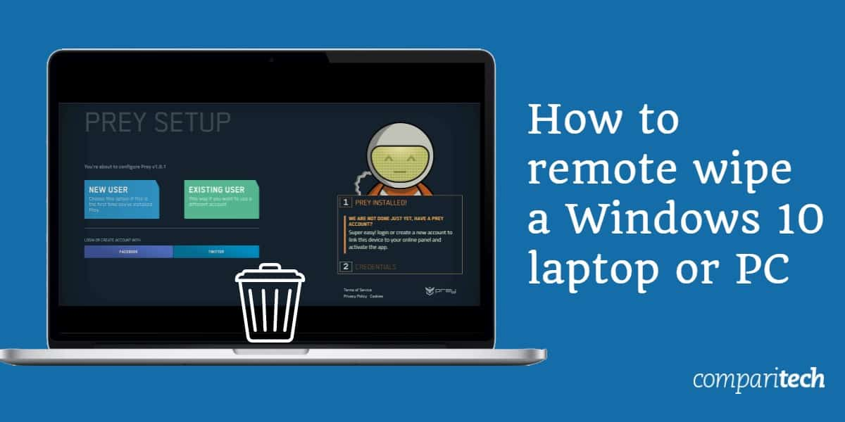
Wireless and Mobile Security
Security+
Session 10
Mobile Devices
Remote Wipe / Sanitation
When part of a mobile device configuration, the company administrator can send a command to the mobile device to remotely delete data from the device in case of loss or compromise.

Slide 14
Wireless and Mobile Security
Security+
Session 10
Mobile Devices
Security Measures for Mobile Devices
Screen Lock
Strong Password
Context-Aware Authentication
Device Encryption
Remote Wipe/Sanitation
Voice Encryption
GPS Tracking
Geofencing
Application Control
Storage Segmentation
Asset Tracking
Device Access Control
Content Management

Slide 15
Wireless and Mobile Security
Security+
Session 10
Mobile Devices
Mobile Device Management (MDM)
Enables IT administrators to securely monitor and manage the mobile devices that access sensitive business data.
It includes storing essential information about mobile devices, deciding which apps can be present on the devices, locating devices, and securing devices if lost or stolen.

Slide 16
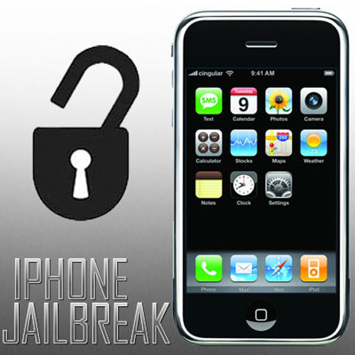
Wireless and Mobile Security
Security+
Session 10
Mobile Devices
Security Concerns
Jailbreaking – to remove the restrictions of the iPhone iOS and be able to get administrative root control of the phone.

Slide 17
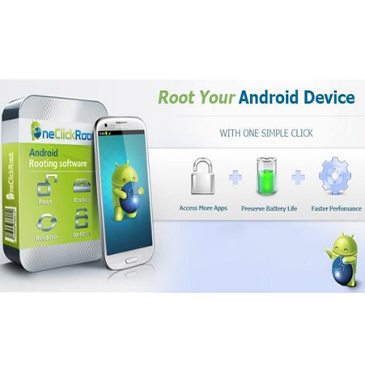
Wireless and Mobile Security
Security+
Session 10
Mobile Devices
Security Concerns
Rooting – being able to get to the root level of a Linux based system, like Android devices.
Sideloading – to be able to transfer data between two devices, on an Android operating system mobile device allows unapproved apps to be loaded.

Slide 18
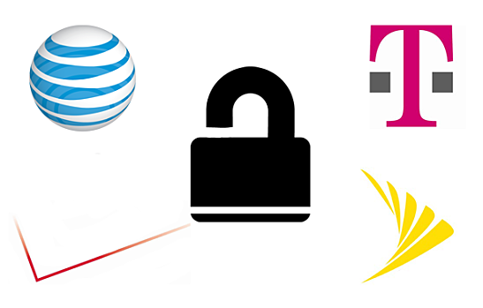
Wireless and Mobile Security
Security+
Session 10
Mobile Devices
Security Concerns
Carrier Unlocking – unlocking a phone to move it from the issuing carrier to another carrier
Over the Air Updates (OTA) – updating the official firmware of a mobile device.

Slide 19
Wireless and Mobile Security
Security+
Session 10
Mobile Devices
Knowledge Check 2
A company is allowing a BYOD policy for its staff.
Which of the following is a best practice that can decrease the risk of users jailbreaking mobile devices?
A. Install a corporately monitored mobile antivirus on the devices.
B. Prevent the installation of applications from a third-party application store.
C. Build a custom ROM that can prevent jailbreaking.
D. Require applications to be digitally signed.

Slide 20
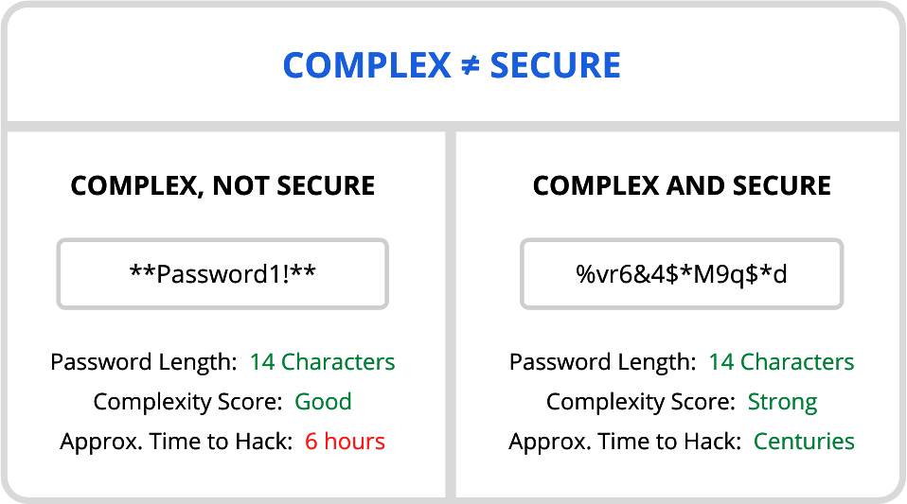
Wireless and Mobile Security
Security+
Session 10
Account Management Concepts
Password Requirements
Password complexity
Password history
Passphrases
Account lockout
High security environments: passwords must be 14 characters in length,
must be changed every 30 days,
will lockout after 3 wrong attempts,
and must have an Administrator to reset the account.

Slide 21
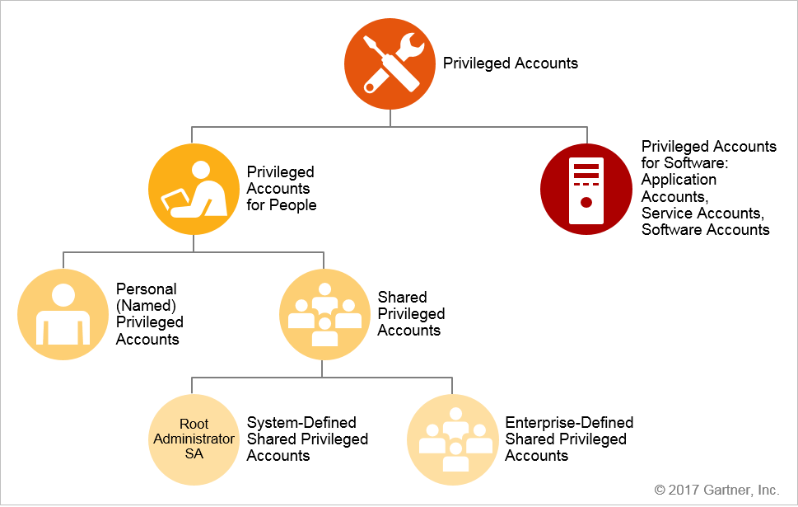
Wireless and Mobile Security
Security+
Session 10
Account Management Concepts
Accounts
User Accounts
Administrator Accounts
Privileged Account
Shared Accounts
Guest Accounts
Service Accounts

Slide 22
Wireless and Mobile Security
Security+
Session 10
Account Management Concepts
Privileged Accounts
Privileged accounts for people.
Personal (named) privileged accounts: A nongeneric personal (named) user account that is assigned to an administrative role or assumes elevated privileges in process, and therefore has access to all standard user as well as privileged operations.
System-defined shared privileged accounts: Accounts that are built into the systems or applications for administrative purposes, such as root on Unix/Linux systems or Administrator on Windows systems.
Enterprise-defined shared privileged accounts: Accounts that are set up for administration, software installation and configuration purposes. Shared by multiple administrators, these accounts also include emergency accounts, also known as "firecall" or "break-glass" accounts, used in the event of an emergency to gain privileged access on a temporary basis.
Privileged accounts for software.
Service, application or software accounts that are used to allow remote interactions (software-to-software) with other systems, applications, databases or services.

Slide 23
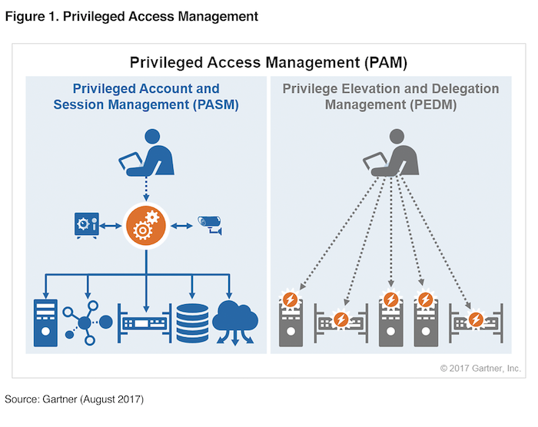
Wireless and Mobile Security
Security+
Session 10
Account Management Concepts
Access Account Audits
Tools for tracking and auditing account access management.
PASM – Privileged Account and Session Management
PEDM – Privilege Elevation and Delegation Management

Slide 24
Wireless and Mobile Security
Security+
Session 10
Account Management Concepts
Principle of Least Privilege (POLP)
Each account is only given the privileges that entity (user or service) needs to do their job.
How to Implement POLP
Conducting privilege audits
Starting all accounts with least privilege
Implementing separation of privileges
Assigning just-in-time privileges
Tracking and tracing individual actions

Slide 25

Wireless and Mobile Security
Security+
Session 10
Account Management Concepts
Principle of Least Privilege (POLP)
Onboarding – account set up with least privilege, and user trained in company network and security policies.
Pre-Offer Checks
Background Check
Credit Check
Resume validation
Education validation
Social Media Check
03/20/21 Teen Vogue Editor Out of a Job Over Old Tweets.
Tweets Alexi McCammond made ten years before, at age 17, come back to haunt her and results in the loss of a high-level position even before she starts.

Slide 26
Wireless and Mobile Security
Security+
Session 10
Account Management Concepts
Principle of Least Privilege (POLP)
Off-boarding – accounts should be disabled as soon as an employee is terminated or leaves the company on good terms or bad terms.
Disable the accounts for a limited amount of time, then delete the account.

Slide 27
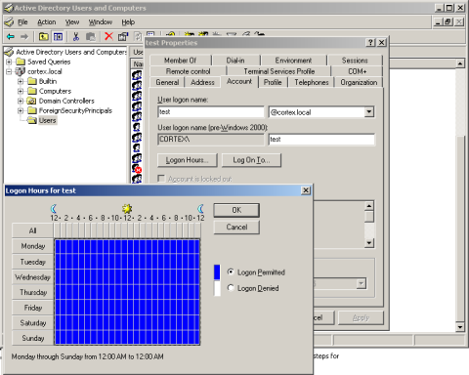
Wireless and Mobile Security
Security+
Session 10
Account Management Concepts
Principle of Least Privilege (POLP)
Time of Day Restrictions – restrict the times of the day when the employee is allowed/expected to logon to the system.
Computer Restrictions – restrict the user to certain computers within the network where the employee is expected to work.
Location-Based Controls – restricting the user to allow/deny access based on location. Example: Not allowed to login from a location in Russia.

Slide 28
Wireless and Mobile Security
Security+
Session 10
Mobile Devices
Knowledge Check 3
A business sector is highly competitive, and safeguarding trade secrets and critical information is paramount. On a seasonal basis, an organization employs temporary hires and contractor personnel to accomplish its mission objectives.
The temporary and contract personnel require access to network resources only when on the clock.
Which of the following account management practices are the BEST ways to manage these accounts?
A. Employ time-of-day restrictions.
B. Employ password complexity.
C. Employ a random key generator strategy.
D. Employ an account expiration strategy.
E. Employ a password lockout policy

Slide 29
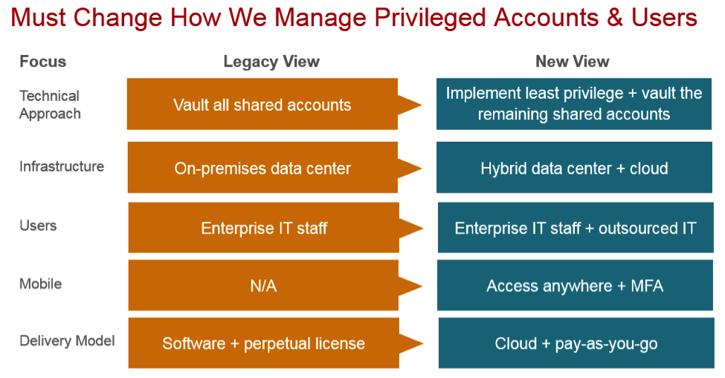
Wireless and Mobile Security
Security+
Session 10
Account Management Concepts

Slide 30
Wireless and Mobile Security
Security+
Session 10
Mobile Devices
Knowledge Check 4
A company has a security policy that specifies all endpoint computing devices should be assigned a unique identifier that can be tracked via an inventory management system. Recent changes to airline security regulations have cause many executives in the company to travel with mini tablet devices instead of laptops.
These tablet devices are difficult to tag and track. An RDP application is used from the tablet to connect into the company network.
Which of the following should be implemented in order to meet the security policy requirements?
A. Virtual desktop infrastructure (IDI)
B. WS-security and geo-fencing
C. A hardware security module (HSM)
D. RFID tagging system
E. MDM software
F. Security Requirements Traceability Matrix (SRTM)

Slide 31
Wireless and Mobile Security
Security+
Session 10
Mobile Devices
Knowledge Check 5
Which of the following attack types is being carried out where a target is being sent unsolicited messages via Bluetooth?
A. War chalking
B. Bluejacking
C. Bluesnarfing
D. Rogue tethering

Slide 32
Wireless and Mobile Security
Security+
Session 10
Mobile Devices
Knowledge Check 6
A security manager is creating an account management policy for a global organization with sales personnel who must access corporate network resources while traveling all over the world.
Which of the following practices is the security manager MOST likely to enforce with the policy? (Select TWO)
A. Time-of-day restrictions
B. Password complexity
C. Location-based authentication
D. Group-based access control
E. Standard naming convention

Slide 33
Wireless and Mobile Security
Security+
Session 10
Mobile Devices
Knowledge Check 7
To help prevent one job role from having sufficient access to create, modify, and approve payroll data, which of the following practices should be employed?
A. Least privilege
B. Job rotation
C. Background checks
D. Separation of duties

Slide 34
Wireless and Mobile Security
Security+
Session 10
Mobile Devices
Knowledge Check 8
During a third-party audit, it is determined that a member of the firewall team can request, approve, and implement a new rule-set on the firewall.
Which of the following will the audit team most l likely recommend during the audit out brief?
A. Discretionary access control for the firewall team
B. Separation of duties policy for the firewall team
C. Least privilege for the firewall team
D. Mandatory access control for the firewall team

Slide 35
Wireless and Mobile Security
Security+
Session 10
Mobile Devices
Knowledge Check 9
A department head at a university resigned on the first day of the spring semester. It was subsequently determined that the department head deleted numerous files and directories from the server-based home directory while the campus was closed.
Which of the following policies or procedures could have prevented this from occurring?
A. Time-of-day restrictions
B. Permission auditing and review
C. Offboarding
D. Account expiration

Slide 36
Wireless and Mobile Security
Security+
Session 10
Mobile Devices
Knowledge Check 10
A company’s AUP requires:
Passwords must meet complexity requirements.
Passwords are changed at least once every six months.
Passwords must be at least eight characters long.
An auditor is reviewing the following report:
Which of the following controls should the auditor recommend to enforce the AUP?
A. Account lockout thresholds
B. Account recovery
C. Password expiration
D. Prohibit password reuse

Slide 37
Security+
Wireless and Mobile Security
Session 10
Thank You!!
Send questions and slide deck requests to:
Jim Reeves
Security+, CASP+,CySA+, CISSP, ITILv3, CTT+
MCSE, MCSD, MCT
jireeves@Deloitte.com

